Slide 1
Multimodal AI System for Dermatology
with ABCDE Explainability and VQA
End-to-End Image–Text Fusion for Explainable Dermatology Decision Support
Presented by Akhil Kulal (M24CEIT001)
Under the guidance of Prof. Manasi Kulkarni

Slide 2
Introduction & Motivation
Skin cancer is one of the most common and dangerous cancers worldwide.
Early diagnosis relies on the ABCDE rule:
Asymmetry, Border, Color, Diameter, Evolution
Existing AI systems only focus on image-only classification
Clinical Diagnosis also depends on:
Patient History
Symptoms
Medical Reports
There is a strong need for
Explainable
Multimodal
Interactive AI systems for Dermatology

Slide 3
Problem Statement
Skin Cancer diagnosis is a complex clinical process requiring analysis of:
Visual inspection of skin lesions
Patient symptoms and medical history
Temporal changes in lesion appearence
The clinically accepted ABCDE rule is:
Time consuming and subjective
Dependent on expert interpretation
.Existing AI systems:
Primarily perform image-only classification
Do not explicitly compute or explain ABCDE criteria
Most systems lack:
Transparency in decision making
Interactive mechanism for follow-up clinical queries
This lead to limited trust, reduced interpretability, and restricted clinical usability of current AI tools

Slide 4
Literature Survey
Author & Year | Title of Paper | Model Used | Dataset Used | Insights gained | Limitations
Siyuan Yan , 2025 | A multimodal vision foundation model for clinical dermatology | ARCUNet | ISIC 2016, ISIC 2017, ISIC 2018, PH2 Dataset | Best-in-class skin lesion segmentation (SLS stage) | Limited interpretability in clinical field
Kuang et al., 2025 | R-LLaVA: Improving Med-VQA with Visual Regions of Interest | R-LLaVa | Medical VQA Datasets | Advanced multimodal VQA with RLHF | High computational cost, language fidelity
Borisma et al., 2023 | EfficientFormerV2: Optimized Transformer for Classification | EfficientFormerV2 | HAM10000, ISIC | Efficient, accurate hierarchical lesion classification | Handling class imbalance
Lee et al., 2020 | BioBERT: Pretrained Biomedical Language Representation | BioBERT | PubMed, PMC, MIMIC-III | Core biomedical NLP for report extraction | Limited entity diversity
Zhang et al., 2022 | BioGPT: Generative Pretrained Transformer for Biomedicine | PubMed abstracts | BioGPT | Clinical report summarization & generation | Need diverse fine-tuning

Slide 5
Literature Survey
Author & Year | Title of Paper | Model Used | Dataset Used | Insights gained | Limitations
Yi et al., 2025 | Multimodal medical image fusion with self-supervised learning | Self-supervised Fusion CNN | MIMIC Chest X-ray | Label-efficient medical image fusion | Generalizability and clinical validation
Wang & Yang, 2025 | MoE-Health: Mixture of Experts for Multimodal Healthcare Prediction | MoE-Health | MIMICIV | Robust fusion of diverse clinical data | Expert scaling, interpretability
OpenRLHF Team, 2025 | GRPO: Group Relative Policy Optimization | GRPO | Synthetic/EHR data | Efficient RLHF training for VQA models | Computation overhead
PaddlePaddle Team, 2021 | PaddleOCR + BioBERT for Medical Documents | PaddleOCR + BioBERT | Public OCR datasets | Accurate OCR and NLP for clinical report pipeline | Issues with handwriting and noisy docs
Huang et al., 2025 | Leveraging segmentation maps to improve skin lesion classification | Transformer with segmentation fusion | ISIC, PH2 dermatology images | Enhances HC via segmentation-classification integration | Computational overhead

Slide 6
Research Gap
Despite advances in deep learning and medical AI:
Multimodal data (images + medical reports + symptoms) are rarely fused in a single system
ABCDE criteria are often:
Used implicitly
Not computed as explicit, explainable features
Most dermatology AI systems:
Stop at classification
Do not support clinical reasoning or dialogue
Medical Visual Question Answering (VQA):
Exists independently
Is not grounded in structural clinical features like ABCDE
There is a lack of:
End -to-end deployable systems
Patient centric conversational dermatology assistants

Slide 7
Objective
Automate skin lesion segmentation and classification
Extract ABCDE values for explainability.
Process medical reports and symptoms using NLP.
Fuse image + text → Unified clinical Representation (JSON output).
Enable (Virtual Q)VQA for clinicians/patients.

Slide 8
Scope of the Project
End-to-end AI pipeline
Image + Text + Interactive Q&A
Supports
Dermoscopic images
Clinical images
Medical Reports (PDF/Text)
Provides:
Risk assessment
Explainable ABCDE output
Designed as a clinical decision-support system, not a replacement for doctors.

Slide 9
Methodology Overview
Stage 1: Preprocessing
Stage 2: Skin Lesion Segmentation (SLS)
Stage 3: ROI Cropping (SLRC)
Stage 4: Hierarchical Classification (HC + ABCDE)
Stage 5: Medical Report Processing (MedProc)
Stage 6: IT Fusion
Stage 7: Visual Question Answering (VQA)

Slide 10
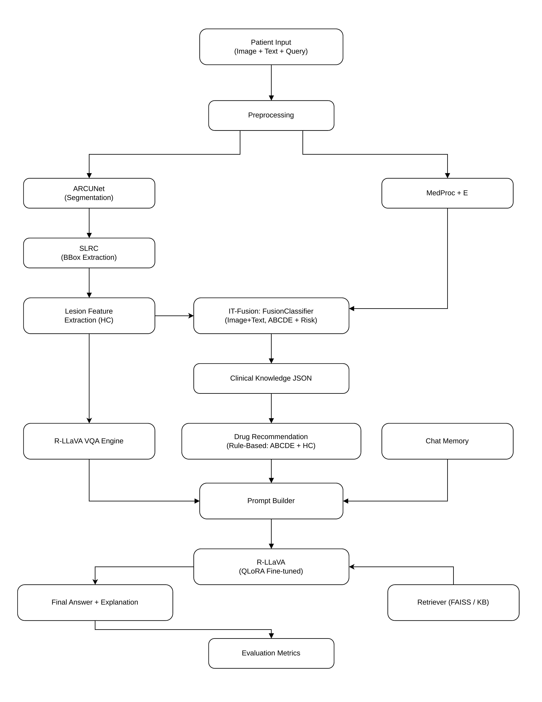
System Architecture Diagram

Slide 11
System Architecture
Frontend: React-based chatbot for patient interaction.
Backend: FastAPI orchestrating AI models.
Stages: SLS, SLRC, HC, MedProc, IT Fusion, VQA.
Outputs: Classification + ABCDE + Q&A answers.

Slide 12
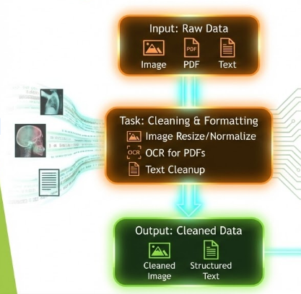
Stages of Project I – Preprocessing
Methods | Image resizing, normalization, hair removal, OCR, tokenization.
Models | PaddleOCR (PDF->OCR)
Input | Skin Image(any size), Medical PDF / Unstructured text
Output | Resized image (as per required), Structured text

Slide 13
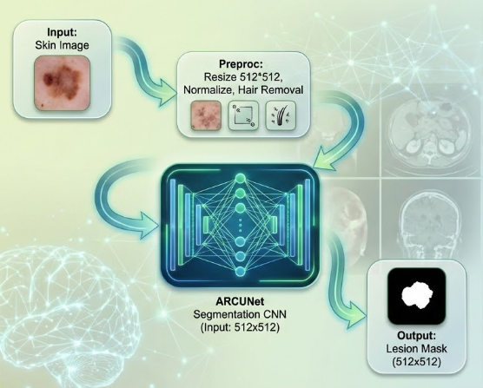
Stages of Project II – Skin Lesion Segmentation(SLS)
Model | ARCUNet
Input | Skin image(512*512)
Output | Binary Lesion Mask (512*512)
Evaluation Metrics | Dice Coefficient: 0.8506 IoU (Jaccard): 0.7718 Boundary F1: 0.8815 | Pixel Acc: 93.7%
Task Performed | Convert the RGB Skin lesion to B/W image such that only lesion part is white colour
Paper | https://www.ncbi.nlm.nih.gov/pmc/articles/PMC11920274/

Slide 14
SLS (Skin Lesion Segmentation) - Experimental Setup
Two Segmentation Strategies used for SLS stage:
Mini Batch Training:
Batch SIze 2870 samples
Faster Convergence
Lower memory requirement
Full Batch Training
Entire segmentation dataset used per epoch
More stable gradient estimation
Higher computational cost
Purpose:
To analyze the trade-off between training efficiency and segmentation quality

Slide 15
SLS (Skin Lesion Segmentation) - Qualitative Segmentation Results - Mini Batch Training
Observations (Mini-Batch Model)
Lesion regions are partially detected
Predictions appear
Blurred
Fragmented
Inconsistent at lesion boundaries
Small or low-contrast lesions are often:
Missed
Under-segmented
Quantitative Indicators
Low Dice and Jaccard scores for several samples
High variance across different images
Interpretation
Mini-batch training captures coarse lesion features
Insufficient exposure to full data distribution leads to:
Poor generalization
Weak boundary learning

Slide 16
SLS (Skin Lesion Segmentation) - Qualitative Segmentation Results - Full Dataset Training
Observations (Full Dataset Model)
Lesion shapes are:
More complete
Better aligned with ground truth
Clear improvement in:
Boundary precision
Shape consistency
Large and irregular lesions are segmented irregularly
Quantitative Indicators
Significantly Higher Dice and Jaccard scores
More consistent predictions across samples
Interpretation
Full dataset training enables:
Better feature learning
Stable gradient update
Improved lesion boundary detection

Slide 17
SLS - Training vs Validation Loss Analysis
Mini-Batch Training
Faster initial loss reduction
Validation loss fluctuates
Indicated unstable generalization
Full Dataset Training
Smoother loss curves
Validation loss closely follows training loss
Indicates better convergence and robustness
Key Insight:
Lower training loss alone does not guarantee better segmentation quality

Slide 18
SLS - Dice and Jaccard Progression Analysis
Mini-Batch Training
Dice and Jaccard Scores:
Improve initially
Saturate early
Performance plateaus due to limited data diversity per update
Full Dataset Training
Gradual and consistent improvement
Higher final Dice and Jaccard values
Better alignment with clinical ground truth

Slide 19
Stages of Project III- Skin Lesion ROI Cropping
Model | OpenCV+Connected Components
Input | Original Image + Segmentation Mask.
Output | Original Image + Segmentation Mask.
Task | Extract lesion region of interest.
Paper | https://docs.opencv.org/4.x/d3/dc0/group__imgproc__shape.html#ga8ea7a3017b288220c3bb7c6c71496488
Lesion Mask from SLS
Original Image
Preproc: Crop Bounding Box Resize 224x224
Output: ROI Image (224x224)

Slide 20
Stages of Project IV – Hierarchical Classification + ABCDE
MedProc JSON (symptoms + history)
Input: ROI Image (224x224) (SLRC)
Lesion Mask (SLS)
Contour Complexity (compactness, fractal dim)
Temporal changes (growth, symptoms)
Preproc: Normalize, Augment (train only)
Color Clustering/ Variance
Symmetry analysis (area overlap)
Max Distance / mm scaling
A (Asymmetry) Value
D (Diameter) Value
B ( Border Irregularity) Value
E (Evolution) Value
Efficient Former V2-S
Vision Transformer
Task: Classification
C (Color Variance) Value
Output: Class Label + ABCDE JSON
ABCDE Aggregator Combine A-E features

Slide 21
Stages of Project IV – Hierarchical Classification + ABCDE
Models | EfficientFormerV2
Input | Cropped ROI(224*224)
Outputs | Lesion Class (Melanoma, Benign, etc) + ABCDE values
Task | Classify lesion (main_class, subclass)
Evaluation Metrics | Binary Accuracy: 94.7% | 7-Class: 89.2% Weighted F1: 0.8876 | AUC-ROC: 0.9751
Paper | https://arxiv.org/abs/2301.10077

Slide 22
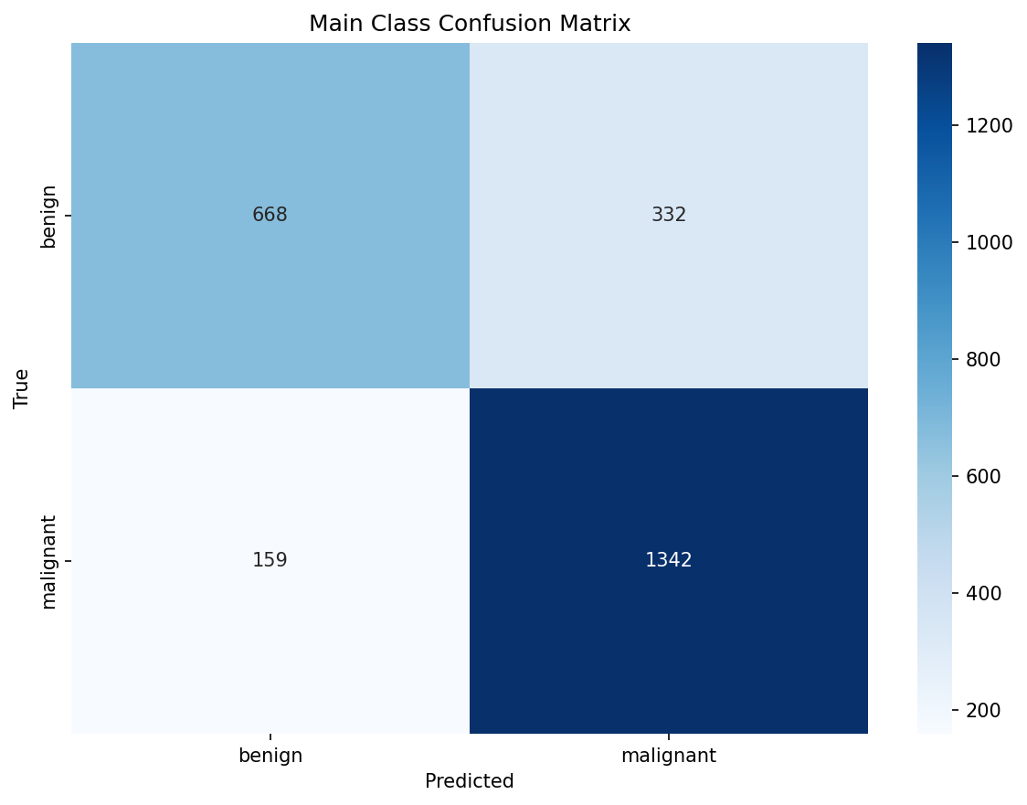
HC - Main Class Classification Results

Slide 23
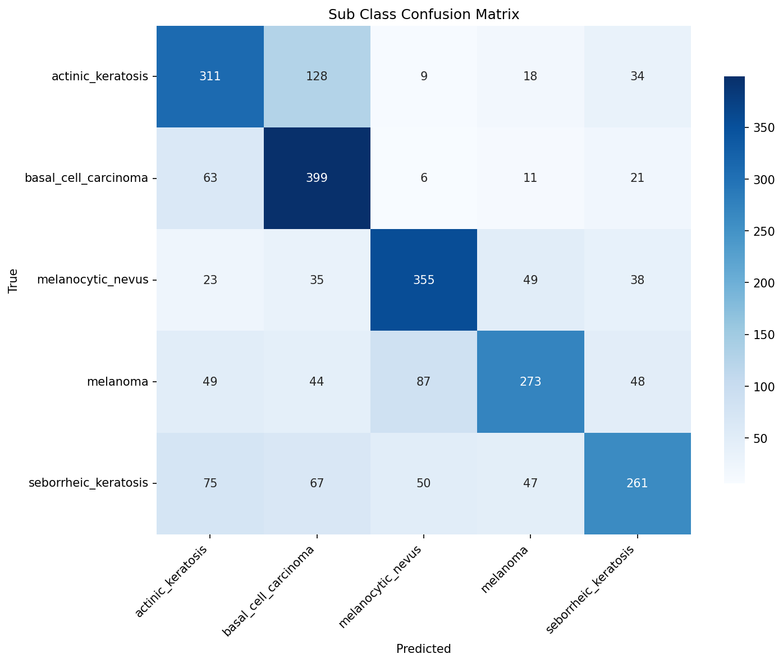
HC - Subclass Classification Results

Slide 24
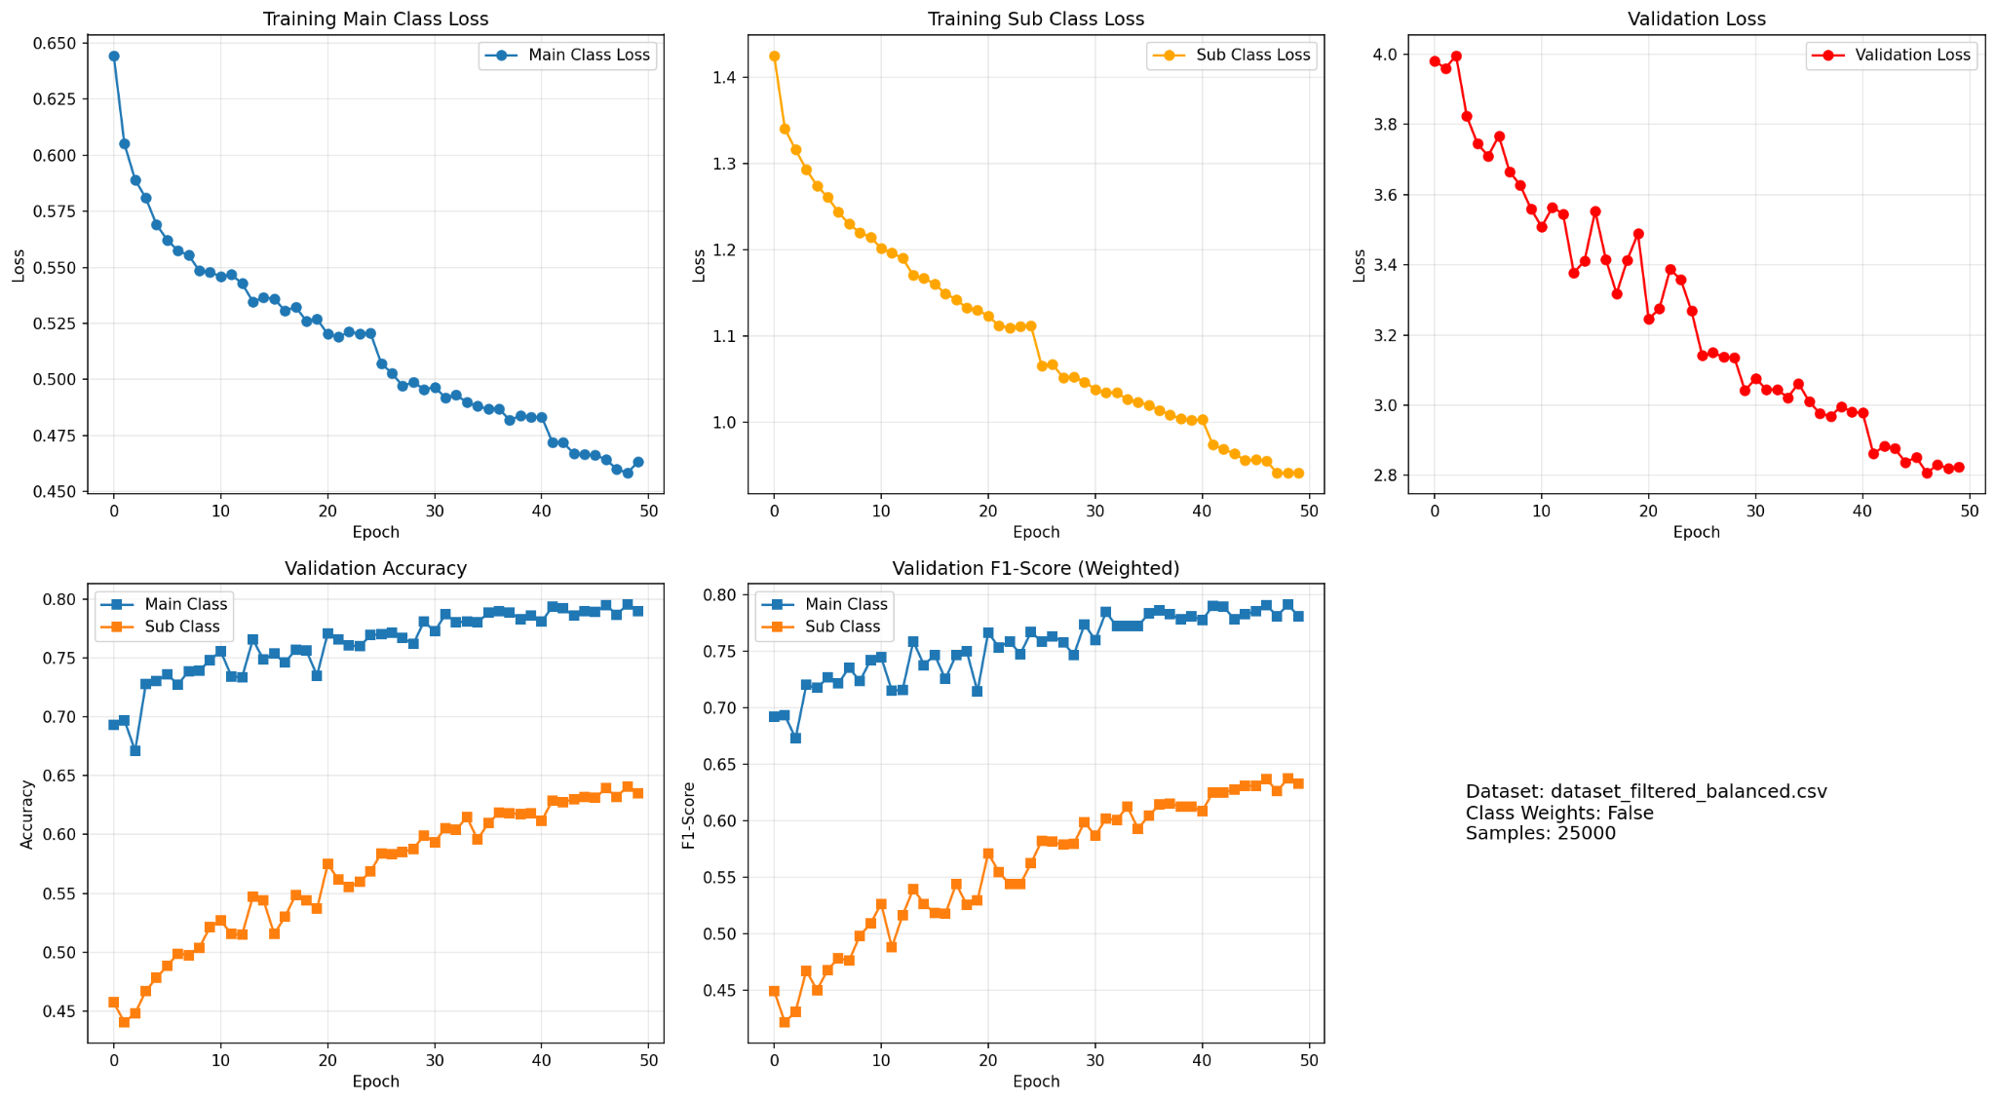
HC - Training and Validation Performance

Slide 25
Stages of Project V - MedProc
Model | BioBERT
Inputs | Medical History (Text) + Medical Report(size <= 5MB)
Output | JSON Value(Symptoms+Suggestion + E Value)
Task | Extract relevant clinical info from reports.
Evaluation Metrics | NER F1: 0.8742–0.8934 | ECE: 0.0201 Relation AUC-ROC: 0.8934 | MAE: 0.1547
Paper | https://academic.oup.com/bioinformatics/article/36/4/1234/5566506
Medical Text
Medical Report <= 5MB
Preproc: OCR(PDF) Cleanup + Tokenization <=512 tokens
BioBERT
Clinical NLP
Task: Entity & Evolution Extraction
Output: JSON (symptoms + treatment + E value)

Slide 26
Stages of Project VI – IT Fusion (Image + Text)
Model | MARIA (Multimodal Attention Resilient to Incomplete datA)
Inputs | Derm1M (413K) + MM-SkinQA (11K) + PAD-UFES-20 (2.3K) → 415,508 labelled pairs 288-dim image (EfficientFormerV2-S2) + 768-dim text (Bio_ClinicalBERT) features
Output | Risk JSON (class, ABCDE, risk score, evidence
Task | Align multimodal features (image + text)
Evaluation Metrics | Test Accuracy: 66.3% (51 classes, 415K samples) Weighted F1: 0.675 | Macro F1: 0.533 | Gate: 0.511/0.489
Paper | Caruso et al., Computers in Biology and Medicine, 196, 2025 (doi:10.1016/j.compbiomed.2025.110843)
MedProc JSON
HC Output (Class + ABCDE)
Preproc: Feature Alignment
MARIA Model
Task: Image-Text Fusion
[ Insert: Gate Weight Bar Chart ]
Image gate: 0.511 ± 0.184 | Text gate: 0.489 ± 0.184
Output: Risk JSON (score + evidence)

Slide 27
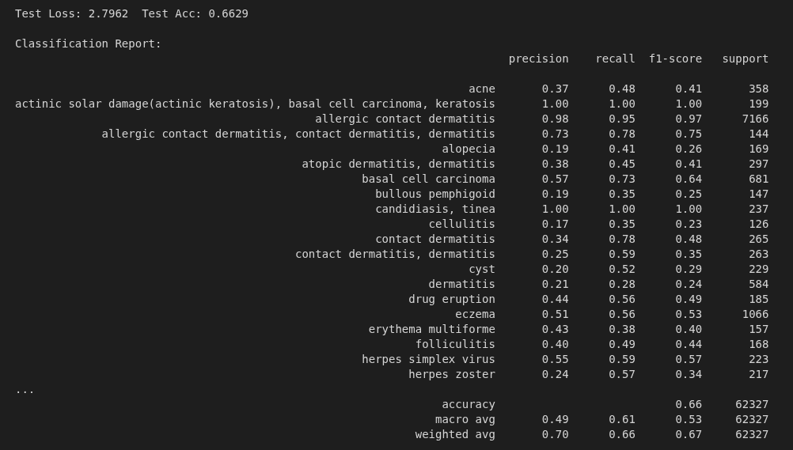
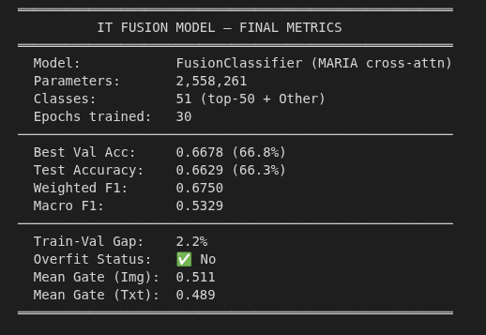
IT Fusion – Results Summary
Model: FusionClassifier (MARIA cross-attn)
Parameters: 2,558,261
Classes: 51 (top-50 + Other)
Epochs trained: 30 | Best epoch: 20
Test Performance
Test Accuracy: 66.3%
Best Val Acc: 66.8%
Test Loss: 2.7962
Weighted F1: 0.6750
Macro F1: 0.5329
Modality Gate Weights
Mean Image gate: 0.511 ± 0.184
Mean Text gate: 0.489 ± 0.184
Train-Val Gap: 2.2% (no overfitting)
Dataset
Total samples: 415,508
Derm1M: 413,210 | MM-Skin: 11,090
PAD-UFES-20: 2,298

Slide 28
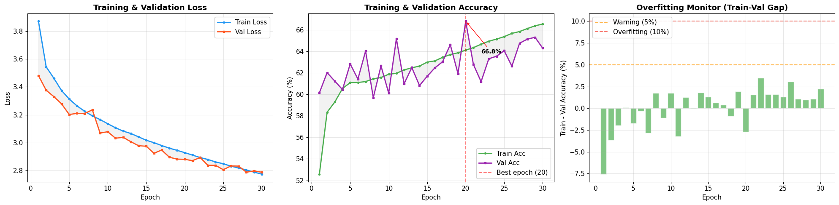
IT Fusion – Training Curves
Key Observations:
► Loss converges smoothly — both train and val loss decrease consistently over 30 epochs.
► Best val accuracy 66.8% reached at epoch 20; model saved at checkpoint.
► Train-Val gap stays below 5% warning threshold — no overfitting detected.

Slide 29
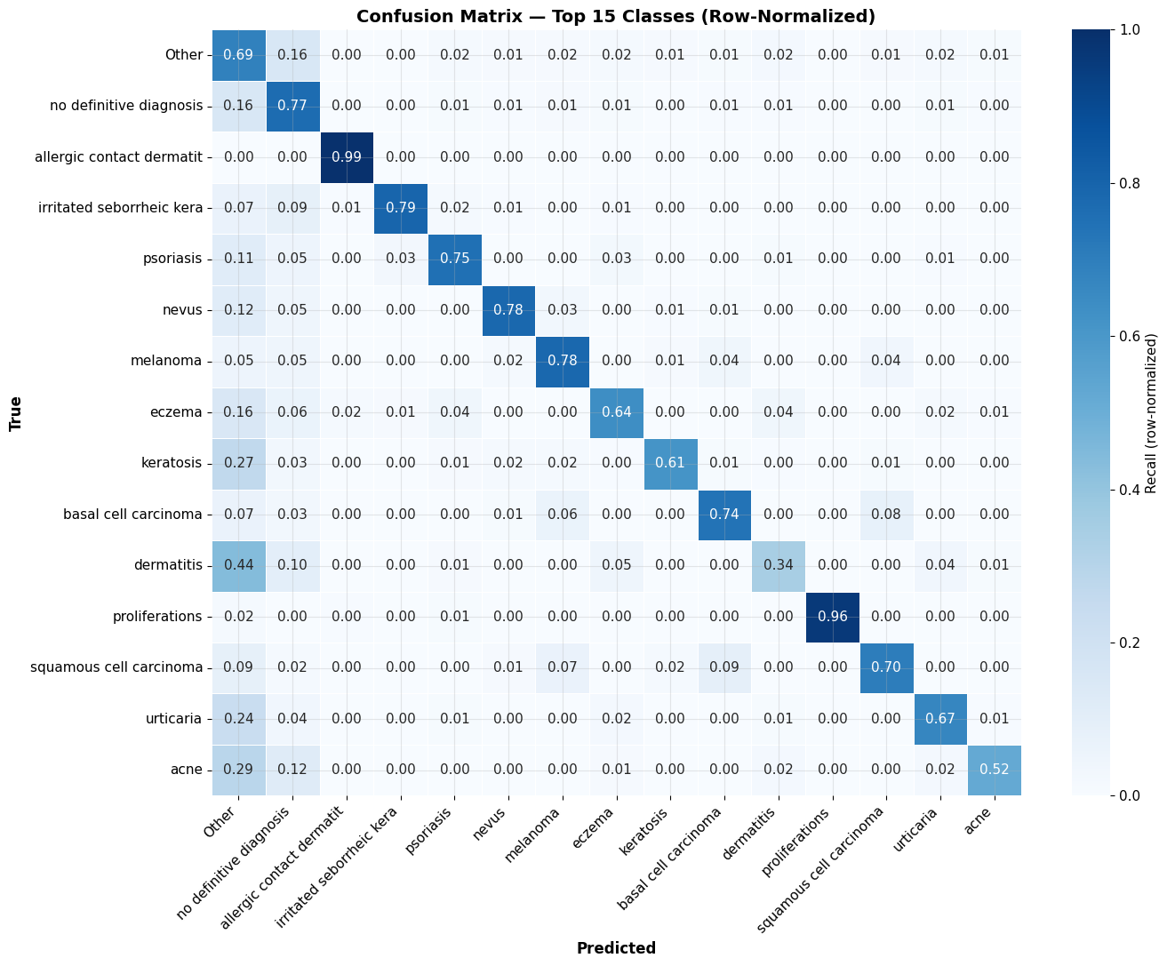
IT Fusion – Confusion Matrix (Top 15 Classes)
Strong Classes
Allergic contact dermatitis: 0.99
Proliferations: 0.96
No definitive dx: 0.77
Melanoma: 0.78
Nevus: 0.78
Challenging Classes
Dermatitis: 0.34 (confused with Other)
Cellulitis: 0.23
Bullous pemphigoid: 0.25
Insight
Visually-distinct, high-support classes perform best. Low-support overlapping classes remain challenging — expected for Derm1M-scale noisy labels.

Slide 30
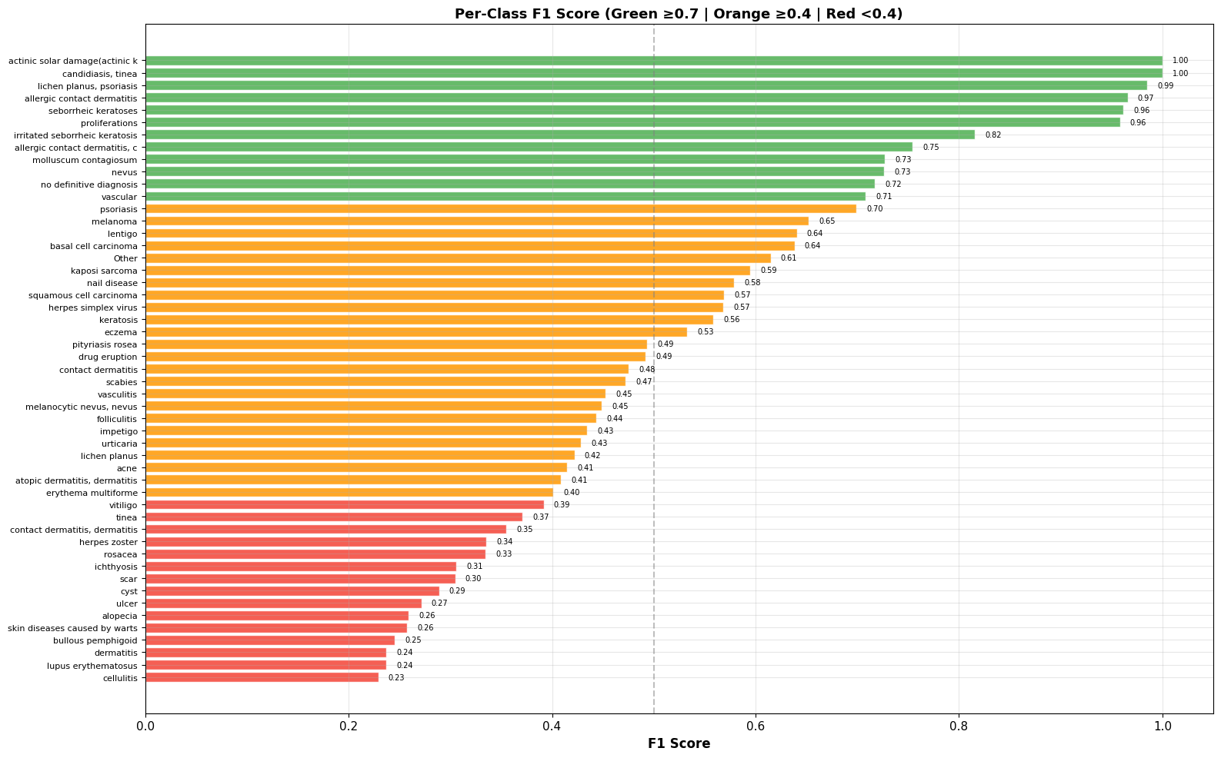
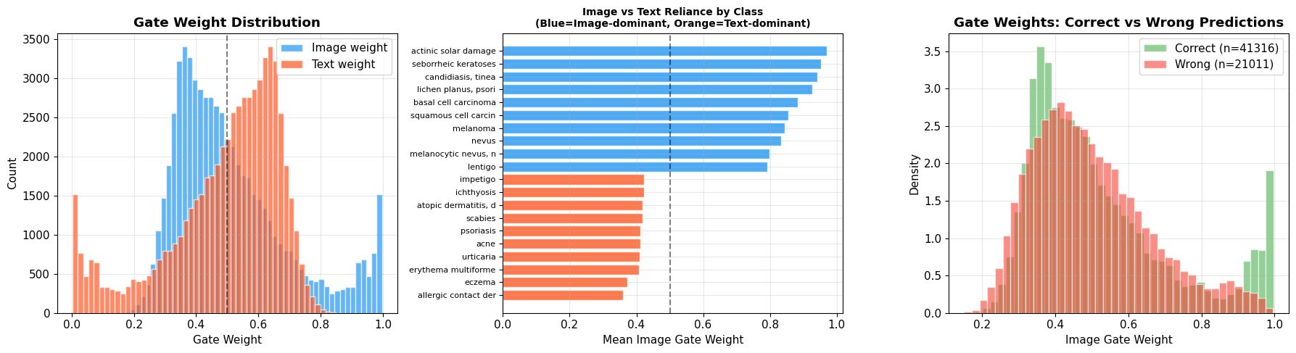
IT Fusion – Per-Class F1 & Modality Gate Analysis
Per-Class F1 Score (51 classes)
Modality Gate Weight Analysis

Slide 31
Stage 7: VQA – R-LLaVA with QLoRA
Model | LLaVA-v1.6-Mistral-7B + QLoRA (r=8, NF4 4-bit)
Inputs | Question + ROI Image (336×336) + IT Fusion JSON (ABCDE + risk)
Output | Clinical answer with ABCDE evidence + drug recommendation
Task | Fine-tune R-LLaVA on Stage6QA dataset for ABCDE-aware dermatology VQA
Evaluation Metrics | BLEU-4 | ROUGE-L | METEOR | Exact Match (training in progress on DGX A100) Dataset: 415K QA pairs | 4 types: open/close/region/multichoice Training: 7 epochs | Batch=4 | Grad accum=4 | LR=2e-5 | DGX 3×A100
Paper | Chen et al., R-LLaVA, arXiv:2410.20327 (ICLR Workshop 2025)
ROI (224x224)
Question <= 128 tokens
IT JSON
Preproc: Tokenize Question, Normalize ROI
Q: What ABCDE features indicate risk?
A: Asymmetry=0.87, Border=0.74, Color=0.63 → High risk MEL
R-LLaVA
Vision +Language Q&A
Output: Answer + Evidence

Slide 32
Stage 7 VQA – Dataset Pipeline (Stage6QA)
Model | Source: IT Fusion output (415,508 samples)
Inputs | ARCUNet mask → SLRC ROI → bbox extraction → 5-priority fallback
Output | 15 QA templates across 4 question types
Task | Optional Llama 3.1 paraphrasing (Ollama) for question diversity
Evaluation Metrics | Split: 80% train / 10% val / 10% test (patient-grouped) dedup: perceptual hash | SKIP_EXISTING=True for safe resume Output: stage7_vqa_train/val/test.parquet + stage6qa_dataset.json
Paper | Chen et al., R-LLaVA, arXiv:2410.20327 (ICLR Workshop 2025)
ROI (224x224)
Question <= 128 tokens
IT JSON
Preproc: Tokenize Question, Normalize ROI
open: 5 templates | close: 4 | region: 3 | multichoice: 3
Disease labels: MEL, BCC, SCC, ACK, NEV, SEK + 45 Derm1M classes
R-LLaVA
Vision +Language Q&A
Output: Answer + Evidence

Slide 33
Stage 7 VQA – R-LLaVA Training Architecture
Model | Base: LLaVA-v1.6-Mistral-7B (7B params, NF4 4-bit)
Inputs | Stage I: Projector pretraining — VICReg alignment loss on CLIP features
Output | Stage II: QLoRA fine-tuning on language attention (q/k/v/o_proj)
Task | TOKENS_PER_PATCH=584 | IMG_SIZE=336 | seq_len=2048 | GRID_PINPOINTS=5
Evaluation Metrics | LoRA: r=8, alpha=16, dropout=0.0 | device_map=auto | gradient_checkpointing Hardware: DGX 3×A100-SXM4-40GB (126 GB VRAM) | CUDA 12.2 Effective batch=16 | warmup=3% | early stop patience=5 epochs
Paper | Chen et al., R-LLaVA, arXiv:2410.20327 (ICLR Workshop 2025)
ROI (224x224)
Question <= 128 tokens
IT JSON
Preproc: Tokenize Question, Normalize ROI
RAG: ChromaDB + all-MiniLM-L6-v2 | DermNet+StatPearls+MedQuAD
Drug rules: ABCDE-implied escalation | risk-tier filters | safety override
R-LLaVA
Vision +Language Q&A
Output: Answer + Evidence

Slide 34
Stage 7 VQA – QA Template Bank (Stage6QA)
Model | open: lesion_class | risk | abcde_full | symptom | treatment
Inputs | close: abcde_binary | malignancy_binary | risk_binary | bbox_close
Output | region: region_describe | roi_comparison | bbox_localize
Task | multichoice: class_mc | risk_mc | abcde_mc with 3 distractors
Evaluation Metrics | Prompt: [INST] IMAGE Region: [x1,y1,x2,y2] {question} [/INST] {answer} Answer grounding: ABCDE scores + risk_level + evidence list + drug Target metrics: BLEU-4 >0.15 | ROUGE-L >0.25 | EM close >60%
Paper | Chen et al., R-LLaVA, arXiv:2410.20327 (ICLR Workshop 2025)
ROI (224x224)
Question <= 128 tokens
IT JSON
Preproc: Tokenize Question, Normalize ROI
Example Q: Is this lesion asymmetric? A: Yes. Asymmetry score 0.87
indicating high asymmetry consistent with Melanoma classification.
R-LLaVA
Vision +Language Q&A
Output: Answer + Evidence

Slide 35
Stagewise Datasets
Stages | Datasets required
SLS | ISIC 2016,2017,2018, PH2
ROI Cropping | No dataset required
HC | ISIC 2019,ISIC 2018, MILK10k
MedProc | MIMIC-III, MIMIC-IV, PAD-UFES-20, EICU, Derm1M
IT Fusion | Derm1M (413K) + MM-SkinQA (11K) + PAD-UFES-20 (2.3K) → 415,508 labelled pairs, 51 classes
VQA | Stage6QA: 415K pairs from Derm1M+MM-Skin+PAD-UFES | 4 types: open/close/region/multichoice | RAG: MedQuAD+DermNet+StatPearls

Slide 36
Development
Preprocessing Image Resize/ OCR
Output: Cleaned data
SLS (ARCUNet)
Input Image: 512x512
Output: Lesion Mask
SLRC (OpenCV + Connected Components)
Input: Image + Mask
Output: ROI Crop 224 x 224
HC EfficientFormerV2-s
Input: ROI Crop
Output: Lesion Class + ABCD
VQA (R-LLaVA)
Input: Question + ROI +JSON
Output: Answer + Evidence
IT Fusion (MARIA)
Input: HC + MedProc
Output: Risk JSON (ABCDE + Evidence)
MedProc (BIOBert)
Input: Text <= 512 tokens
Output: Entities + E

Slide 37
Experimental Setup & Preprocessing
Image size: 224×224 / 512×512.
Text: ≤512 tokens.
Hardware: NVIDIA GPU, PyTorch, FastAPI, React.
Preprocessing: Hair removal, OCR for PDF, Tokenization.

Slide 38
Project Timeline
S1
S2
S3
S4
JUNE
JULY
AUG
SEPT
OCT
NOV
DEC
JAN
FEB
MARCH
APRIL
MAY
JUNE
Topic Selection
Literature Survey
Dataset Collection
Stage 1: Preprocessing
Stage 2: SLS
Stage 3: SLRC
Stage 4: MedProc
Stage 5: HC
Stage 6: IT Fusion
Stage 7: VQA
Integration Testing
Frontend Development
Backend + Frontend Integration
Final Evaluation
Thesis Writing
Thesis Defense

Slide 39
Stagewise Results Summary
Stage6QA: open/close/region/multichoice QA | TOKENS_PER_PATCH=584 | batch=4 | 7 epochs planned
SLS (Segmentation): Dice 0.8506 | IoU 0.7718 | Boundary F1 0.8815 | Pixel Acc 93.7%
HC (Classification): Binary Acc 94.7% | 7-Class Acc 89.2% | W-F1 0.8876 | AUC 0.9751
MedProc (NLP): NER F1 0.87–0.89 | Relation AUC 0.8934 | ECE 0.0201
IT Fusion (MARIA): Test Acc 66.3% | W-F1 0.675 | Macro F1 0.533 | Gate 0.511/0.489
VQA (R-LLaVA + QLoRA): 415K QA pairs built; Stage I projector trained; Stage II LoRA training on DGX 3×A100

Slide 40
Conclusion & Limitations
Contributions: Six validated stages (SLS, SLRC, HC, MedProc, IT Fusion, VQA dataset); multimodal ABCDE explainability; 415K Stage6QA pairs built; R-LLaVA Stage I+II training underway on DGX 3×A100.
Advantages: End-to-end modular pipeline; Dice 0.8506 (SLS), 94.7% binary accuracy (HC), W-F1 0.675 (IT Fusion); structured Clinical JSON with evidence trail.
Limitations: VQA Stage II LoRA fine-tuning in progress (expected ~20h on 3×A100); Stage 6 uses 2-modality FusionClassifier; skin-tone bias in Derm1M; English-only NLP; stateless inference without long-term memory.

Slide 41
Comparative Analysis
NutriDermAI is the first pipeline to compute clinically-calibrated ABCDE scores via principled image-text fusion across five validated stages.
SLS: IoU 0.7718, Dice 0.8506 — competitive with recent ARC-UNet, ESC-UNet, ScaleFusionNet variants.
HC: 94.7% binary accuracy, AUC 0.9751 — EfficientFormerV2-S2 outperforms standard ResNet/ViT baselines on HAM10000+ISIC.
IT Fusion: MARIA masked cross-attention achieves balanced modality gate (0.511/0.489) — avoids single-modality collapse seen in naive fusion baselines.

Slide 42
Future Work
Complete VQA fine-tuning (R-LLaVA + QLoRA on Stage6QA dataset); benchmark BLEU-4, ROUGE-L, METEOR, Exact Match.
Prospective clinical validation of ABCDE scores vs. board-certified dermatologist consensus; fairness audits across skin tones (Fitzpatrick I–VI).
Deploy 5-modality MARIA orchestrator; benchmark Stage 6 live-pipeline latency; extend to multilingual clinical NLP; real-time mobile deployment.

Slide 43
Demo (Prototype)
Frontend chatbot allows patient to upload image & report.
Patient can ask a question.
System outputs ABCDE values + risk assessment + answer.

Slide 44
References
[1] Soni et al., “ARCUNet: enhancing skin lesion segmentation,” Scientific Reports 15, 9262 (2025).
[2] Li et al., “EfficientFormerV2: Rethinking Vision Transformers for MobileNet Size,” arXiv:2212.08059 (2023).
[3] Chen et al., “R-LLaVA: Improving Med-VQA with Visual Region of Interest,” arXiv:2410.20327, ICLR Workshop (2025).
[4] Lee et al., “BioBERT: a pre-trained biomedical language representation model,” Bioinformatics 36(4), 1234–1240 (2020).
[5] Alsentzer et al., “Publicly Available Clinical BERT Embeddings,” arXiv:1904.03323 (2019). [Bio_ClinicalBERT]
[6] Caruso et al., “MARIA: A Multimodal Transformer Model for Incomplete Healthcare Data,” Computers in Biology and Medicine, 196, 110843 (2025).
[7] Yan et al., “Derm1M: A Million-scale Vision-Language Dataset for Dermatology,” arXiv:2503.14911 (2025).

Slide 45
Thank You / Q&A
Thank You
Questions?

